Slide 1

Slide 7- <number>

Slide 2
Chapter 7, Section 2
Relational Database Design by EER-to-Relational Mapping
Copyright © 2007 Ramez Elmasri and Shamkant B. Navathe

Slide 3
Chapter Outline
ER-to-Relational Mapping Algorithm
  Step 1: Mapping of Regular Entity Types
  Step 2: Mapping of Weak Entity Types
  Step 3: Mapping of Binary 1:1 Relation Types
  Step 4: Mapping of Binary 1:N Relationship Types.
  Step 5: Mapping of Binary M:N Relationship Types.
  Step 6: Mapping of Multivalued attributes.
  Step 7: Mapping of N-ary Relationship Types.
Mapping EER Model Constructs to Relations
  Step 8: Options for Mapping Specialization or Generalization.
  Step 9: Mapping of Union Types (Categories).
Slide 7- <number>

Slide 4
Mapping EER Model Constructs to Relations
Step8: Options for Mapping Specialization or Generalization.
  Convert each specialization with m subclasses {S1, S2,….,Sm} and generalized superclass C, where the attributes of C are {k,a1,…an} and k is the (primary) key, into relational schemas using one of the four following options:
    Option 8A: Multiple relations-Superclass and subclasses
    Option 8B: Multiple relations-Subclass relations only
    Option 8C: Single relation with one type attribute
    Option 8D: Single relation with multiple type attributes
Slide 7- <number>

Slide 5
Mapping EER Model Constructs to Relations
Option 8A: Multiple relations-Superclass and subclasses
  Create a relation L for C with attributes Attrs(L) = {k,a1,…an} and PK(L) = k. Create a relation Li for each subclass Si, 1 < i < m, with the attributesAttrs(Li) = {k} U {attributes of Si} and PK(Li)=k. This option works for any specialization (total or partial, disjoint of over-lapping).
Option 8B: Multiple relations-Subclass relations only
  Create a relation Li for each subclass Si, 1 < i < m, with the attributes Attr(Li) = {attributes of Si} U {k,a1…,an} and PK(Li) = k. This option only works for a specialization whose subclasses are total (every entity in the superclass must belong to (at least) one of the subclasses).
Slide 7- <number>

Slide 6

FIGURE 4.4
EER diagram notation for an attribute-defined specialization on JobType.
Slide 7- <number>

Slide 7

FIGURE 7.4
Options for mapping specialization or generalization.
(a) Mapping the EER schema in Figure 4.4 using option 8A.
Slide 7- <number>

Slide 8
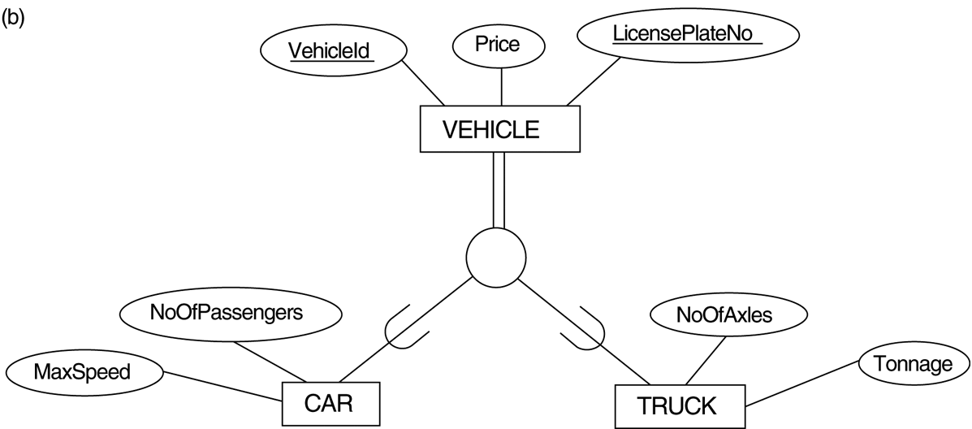
FIGURE 4.3
Generalization. (b) Generalizing CAR and TRUCK into the superclass VEHICLE.
Slide 7- <number>

Slide 9

FIGURE 7.4
Options for mapping specialization or generalization.
(b) Mapping the EER schema in Figure 4.3b using option 8B.
(add “Tonnage”)
Slide 7- <number>

Slide 10
Mapping EER Model Constructs to Relations (contd.)
Option 8C: Single relation with one type attribute
  Create a single relation L with attributes Attrs(L) = {k,a₁,…a_{n}} U {attributes of S₁} U…U {attributes of S_{m}} U {t} and PK(L) = k. The attribute t is called a type (or discriminating) attribute that indicates the subclass to which each tuple belongs
Option 8D: Single relation with multiple type attributes
  Create a single relation schema L with attributes Attrs(L) = {k,a₁,…a_{n}} U {attributes of S₁} U…U {attributes of S_{m}} U {t₁, t₂,…,t_{m}} and PK(L) = k. Each t_{i}, 1 < I < m, is a Boolean type attribute indicating whether a tuple belongs to the subclass S_{i}.
Slide 7- <number>

Slide 11
FIGURE 4.4
EER diagram notation for an attribute-defined specialization on JobType.
Slide 7- <number>

Slide 12
FIGURE 7.4
Options for mapping specialization or generalization.
(c) Mapping the EER schema in Figure 4.4 using option 8C.
(add “EngType”)
Slide 7- <number>

Slide 13

FIGURE 4.5
EER diagram notation for an overlapping (non-disjoint) specialization.
Slide 7- <number>

Slide 14
FIGURE 7.4
Options for mapping specialization or generalization. (d) Mapping Figure 4.5 using option 8D with Boolean type fields Mflag and Pflag.
Slide 7- <number>

Slide 15
Mapping EER Model Constructs to Relations (contd.)
Mapping of Shared Subclasses (Multiple Inheritance)
  A shared subclass, such as STUDENT_ASSISTANT, is a subclass of several classes, indicating multiple inheritance. These classes must all have the same key attribute; otherwise, the shared subclass would be modeled as a category.
  We can apply any of the options discussed in Step 8 to a shared subclass, subject to the restriction discussed in Step 8 of the mapping algorithm. Below both 8C and 8D are used for the shared class STUDENT_ASSISTANT.
Slide 7- <number>

Slide 16

FIGURE 4.7
A specialization lattice with multiple inheritance for a UNIVERSITY database.
Slide 7- <number>

Slide 17
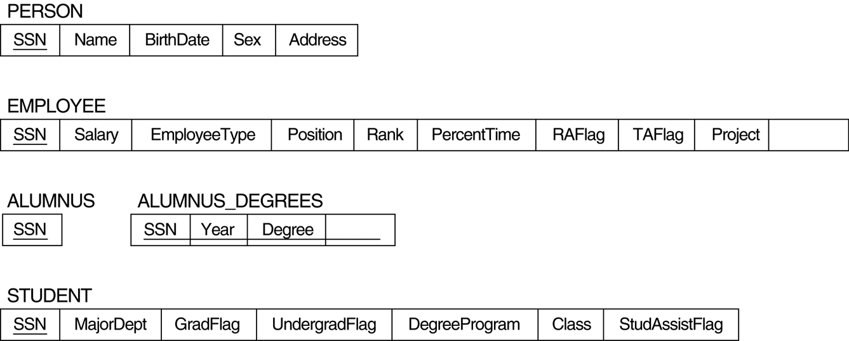
FIGURE 7.5
Mapping the EER specialization lattice in Figure 4.6 using multiple options.
(add “Course” and “Major”)
Slide 7- <number>

Slide 18
Mapping EER Model Constructs to Relations (contd.)
Step 9: Mapping of Union Types (Categories).
  For mapping a category whose defining superclass have different keys, it is customary to specify a new key attribute, called a surrogate key, when creating a relation to correspond to the category.
  In the example below we can create a relation OWNER to correspond to the OWNER category and include any attributes of the category in this relation. The primary key of the OWNER relation is the surrogate key, which we called OwnerId.
Slide 7- <number>

Slide 19

FIGURE 4.8
Two categories (union types): OWNER and REGISTERED_VEHICLE.
Slide 7- <number>

Slide 20
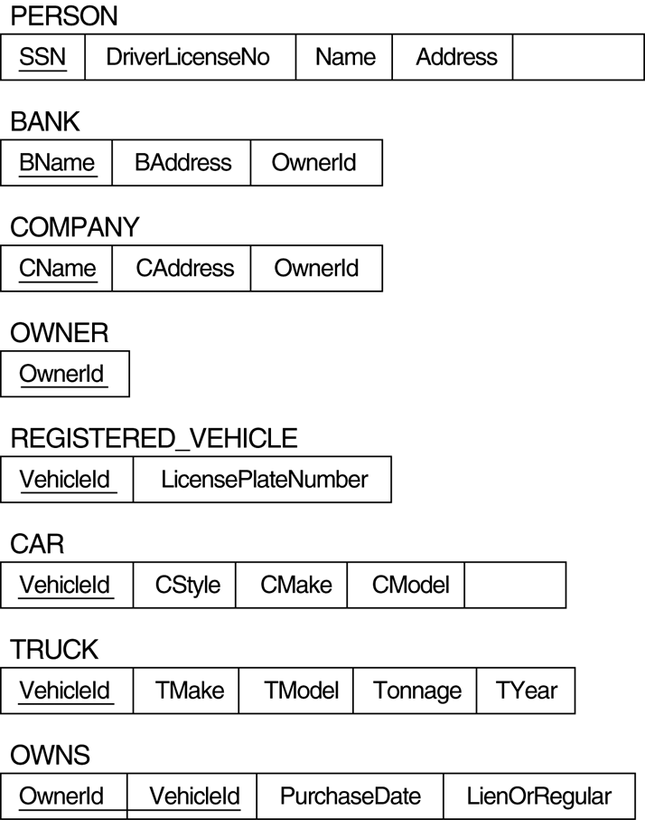
FIGURE 7.6
Mapping the EER categories (union types) in Figure 4.7 to relations.
(Add “OwnerId” and “”Cyear”)
Slide 7- <number>

Slide 21

Mapping Exercise
Exercise 7.4.
FIGURE 7.7
An ER schema for a SHIP_TRACKING database.
Slide 7- <number>

Slide 22
Chapter Summary
ER-to-Relational Mapping Algorithm
  Step 1: Mapping of Regular Entity Types
  Step 2: Mapping of Weak Entity Types
  Step 3: Mapping of Binary 1:1 Relation Types
  Step 4: Mapping of Binary 1:N Relationship Types.
  Step 5: Mapping of Binary M:N Relationship Types.
  Step 6: Mapping of Multivalued attributes.
  Step 7: Mapping of N-ary Relationship Types.
Mapping EER Model Constructs to Relations
  Step 8: Options for Mapping Specialization or Generalization.
  Step 9: Mapping of Union Types (Categories).
Slide 7- <number>

